Slide 1
Platform as a Service
Lecturer: Ngo Huy Bien
Software Engineering Department
Faculty of Information Technology
University of Science
Ho Chi Minh City, Vietnam
nhbien@fit.hcmus.edu.vn

Slide 2

Objectives
To create a PaaS application.

Slide 3

Contents
Salesforce Platform Case Study
Google App Engine
PaaS Pattern

Slide 4

References
Gautam Shroff (2010). Enterprise Cloud Computing. Cambridge University Press.
Keiko Hashizume et al. (2012). Cloud Service Model Patterns.

Slide 5
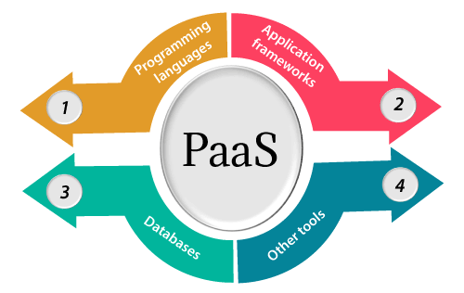
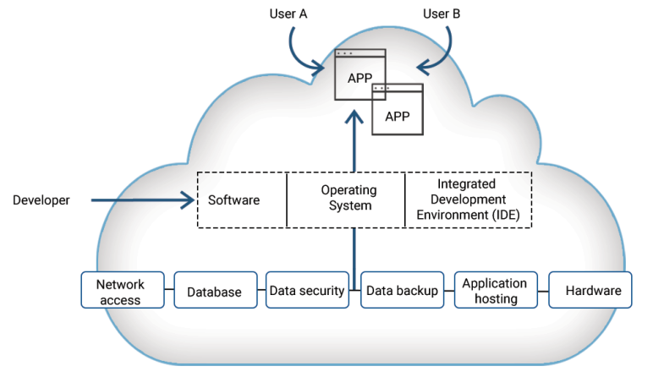
Platform as a Service
The capability provided to the consumer is to deploy onto the cloud infrastructure consumer-created or acquired applications created using programming languages, libraries, services, and tools supported by the provider.
The consumer does not manage or control the underlying cloud infrastructure including network, servers, operating systems, or storage, but has control over the deployed applications and possibly configuration settings for the application-hosting environment.

Slide 6

Salesforce Platform Case Study
https://trailhead.salesforce.com/content/learn/projects/build-a-data-model-for-a-travel-approval-app

Slide 7
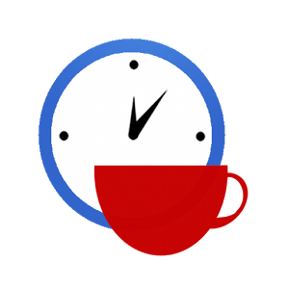

Slide 8
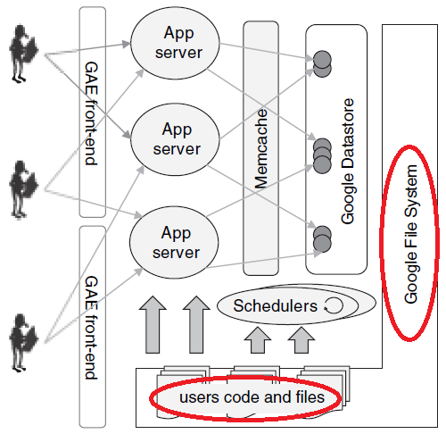
Google App Engine [1]

Slide 10
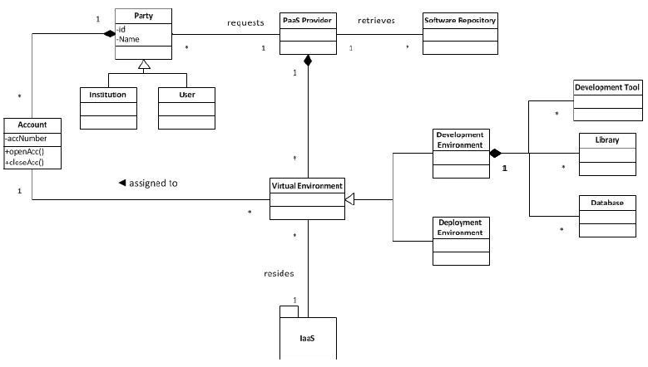
Cloud Platform Pattern [2]

Slide 11
PaaS – Structure
A Party can be an institution or a user (developers, administrators).
The PaaS Provider processes requests from Parties.
The Party will choose the developing tools from the Software Repository which contains a list of developing tools available for the users.
The PaaS provider offers Virtual Environments such as Development Environment and Deployment Environment.
The Virtual Environments are built upon the IaaS (Infrastructure-as-a-Service) which provides the underlying hardware.
The Development Environment is composed of Development Tools, Libraries, Databases.

Slide 12

Thank You & See You Again

